Slide 1



PID controller
By
Himel kundu (1906014) &
Md. Rowatul Jannat rafi (1906016)

Slide 2
General overview
PID
A proportional-integral-derivative controller is a control loop feedback mechanism widely used in industrial systems.
A PID is the most commonly used feedback controller.
A PID controller calculates an “error” value as the difference between a measured process variable and a desired set point. The controller attempts to minimize error by adjusting the process control inputs.
PROPORTIONAL
DERIVATIVE
INTEGRAL

Slide 3
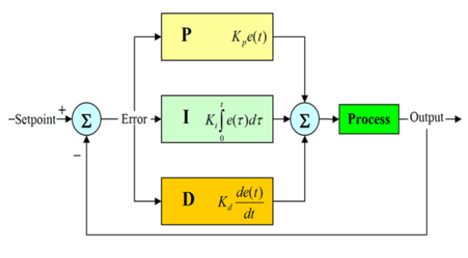
PID Block diagram

Slide 4
WORKING PROCEDURE
The PID controller calculation involves 3 separate parameters, and is accordingly sometimes called three-term control: proportional, integral and derivative; denoted by P, I and D respectively.
P depends on the present error, I on the past accumulation of past errors and D is a prediction of future errors based on current rate of change.
The weighted sum of these three actions is used to adjust the process variable.
By tuning the three constants in the PID controller algorithm, the controller can provide control action designed for specific process requirements.

Slide 5
PROPORTIONAL TERM
The proportional term is given by: P_{out} =K_{p} e(t) ; e(t) = error signal (Set point – process variable)
A high proportional gain (K_{p}) results in a large change in the output for a given change in the error
If the proportional gain is too high, the system can become unstable
In contrast, a small gain results in a small output response to a large input error, and a less responsive (or sensitive) controller. If the proportional gain is too low, the control system may be too small when responding to the system

Slide 6
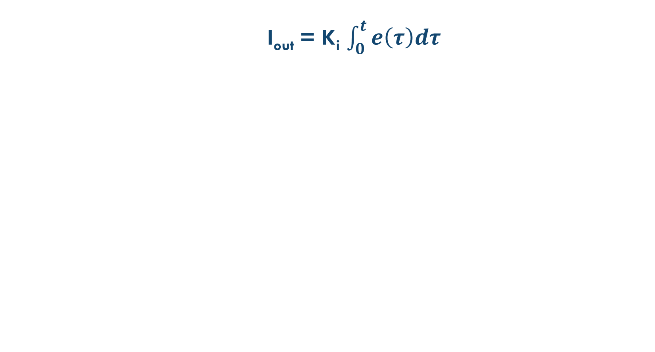
Integral term
The integral term is given by: I_{out} = K_{i} $\int_{0}^{t}{e\left(τ\right)dτ}$
The contribution from the integral term is proportional to both the magnitude of the error and the duration of the error
Summing the instantaneous error over time (integrating the error) gives the accumulated offset that should have been corrected previously
The integral term accelerates the movement of the process towards setpoint and eliminates the residual steady state error. However, it can cause the present value to overshoot the setpoint value due to the accumulation of past values

Slide 7
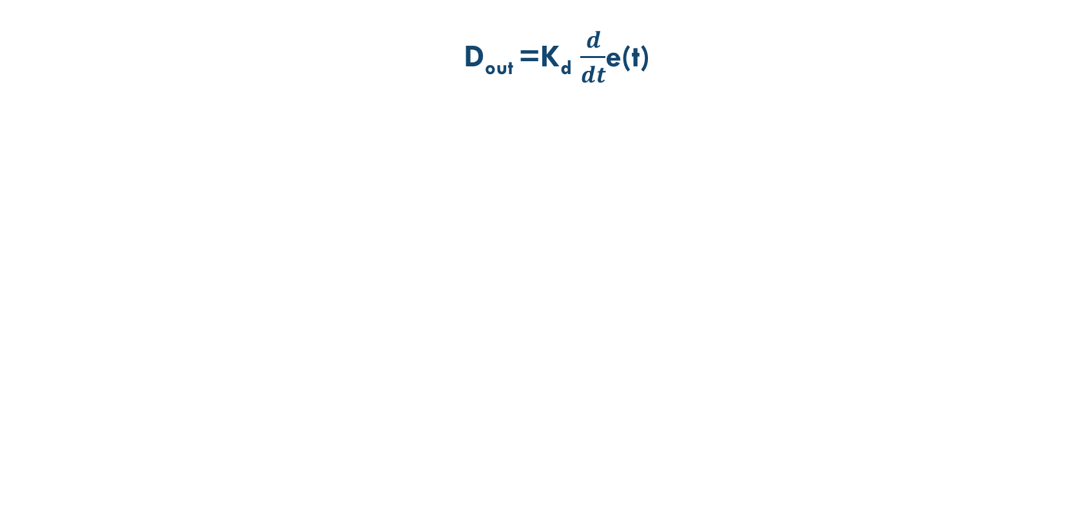
Derivative term
The derivative term is given by: D_{out} =K_{d} $\frac{d}{dt}$e(t)
The rate of change of the process is calculated by determining the slope of the error over and multiplying it by the derivative gain(K_{d})
The derivative term slows the rate of change of the controller ouput and this effect is most noticeable close to the controller setpoint
Hence, derivative control is used to reduce the magnitude of the overshoot produced by the integral component and improve the combined controller-process stability

Slide 8
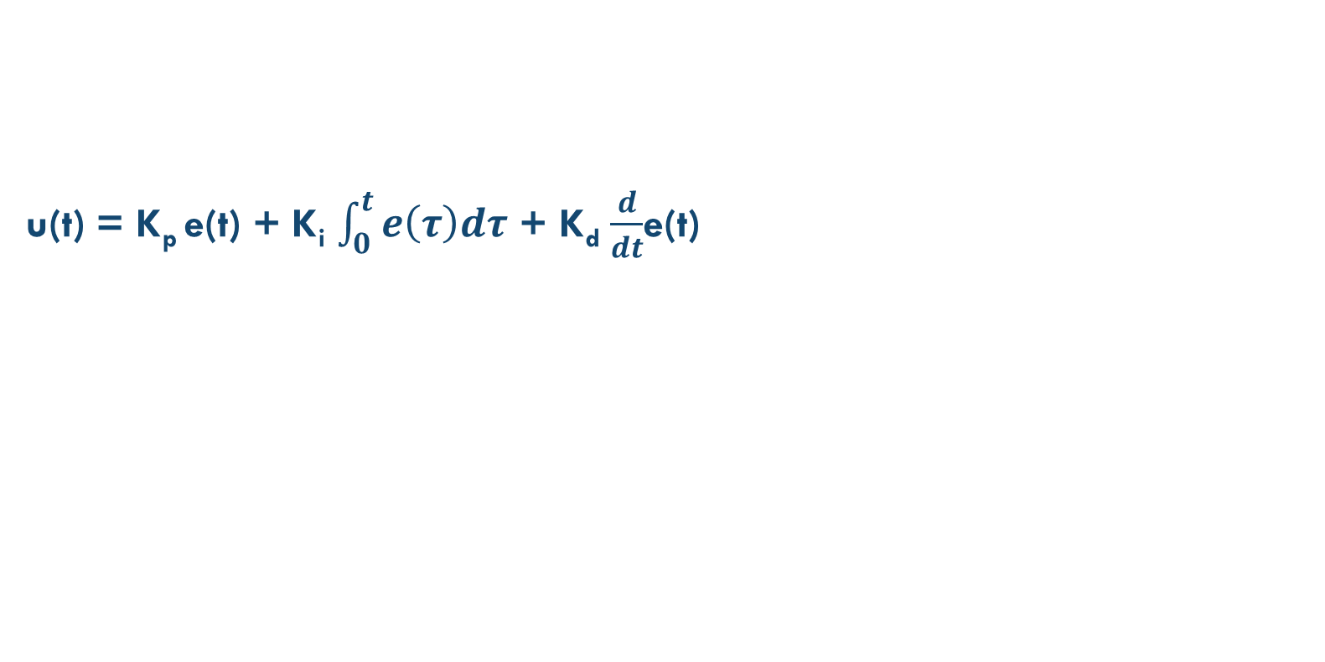
Final output
Defining u(t) as the controller output, the final form of the PID algorithm is
u(t) = K_{p} e(t) + K_{i} $\int_{0}^{t}{e\left(τ\right)dτ}$ + K_{d} $\frac{d}{dt}$e(t)
e(t) = error function (set point – process variable)
K_{p} = proportional gain
K_{i} = integral gain
K_{d} = differential gain

Slide 9
Tuning parameters
K_{p} : Larger values typically mean faster response since the error is larger in that case. However, An excessively large proportional gain will lead to process instability and oscillation
K_{i} : Larger values imply steady state errors are eliminated more quickly. The trade-off is larger overshoot
K_{d} : Larger values decrease overshoot, but slow down transient response and may lead to instability due to signal noise amplification in the differentiation of error

Slide 10
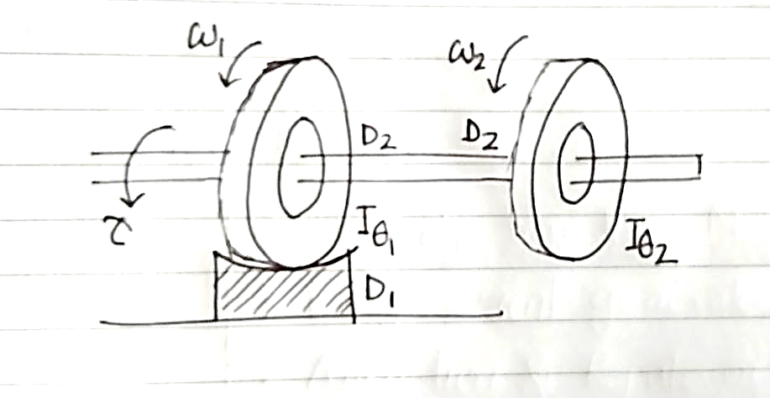
Mechanical Model of the Plant
The mechanical model used as a plant in this project is a two wheeler. The left wheel has a damper attached to it. As a result, for a given applied torque, the speed of the two wheels is not synchronized. The wheel on the right side has higher speed compared to the left wheel. So, it slows down after a delay. This is not an acceptable phenomenon in the automobile manufacture industry. A PID can be used to synchronize the speed of a two wheeler.

Slide 11
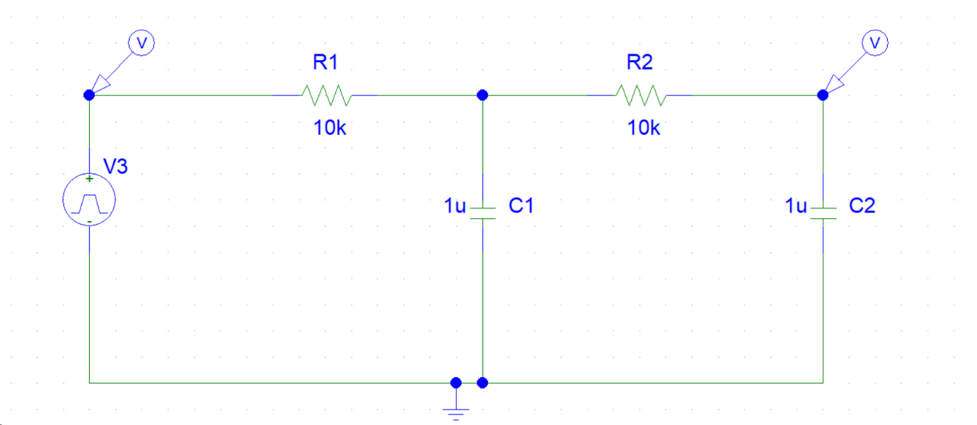
Schematic Diagram of the plant (Analogous to a mechanical system)

Slide 12
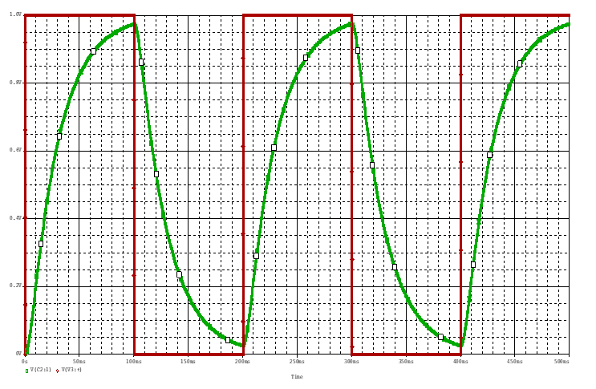
Output of the plant without PID

Slide 13
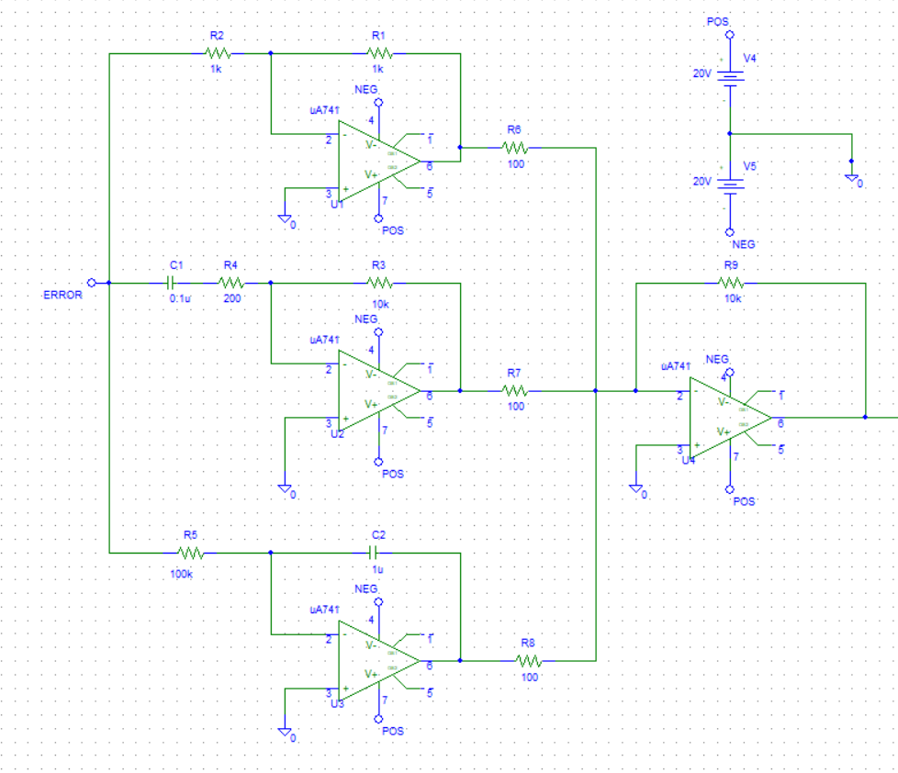
PROPORTIONAL
Schematic of PID Controller
DIFFERENTIAL
INVERTING ADDER
INTEGRAL

Slide 14
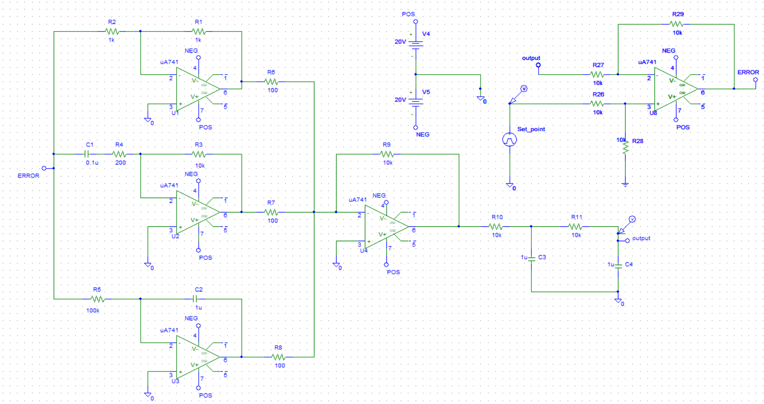
Schematic of PID with tuning

Slide 15
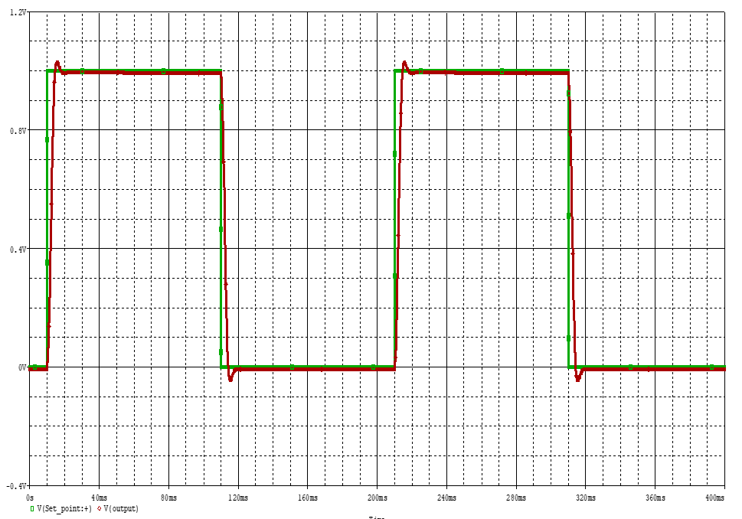
Output after tuning with PID controller

Slide 16
Tuning parameters
Rising time: The time needed for the output to rise from 10% to 90% of the desired output is called rise time
Overshoot: The sudden increase in the amplitude of a signal due the oscillatory nature of a signal is called overshoot.
Steady state error: An error which becomes constant after the transient phase of a signal is called Steady state error. It’s the difference between the output and the desired output at steady state
Stability: It depends on the convergence of the signal. The more the signal gets convergent, the more it becomes stable
Settling time: The time needed for an oscillation to die out completely( up to 90-95%)

Slide 17
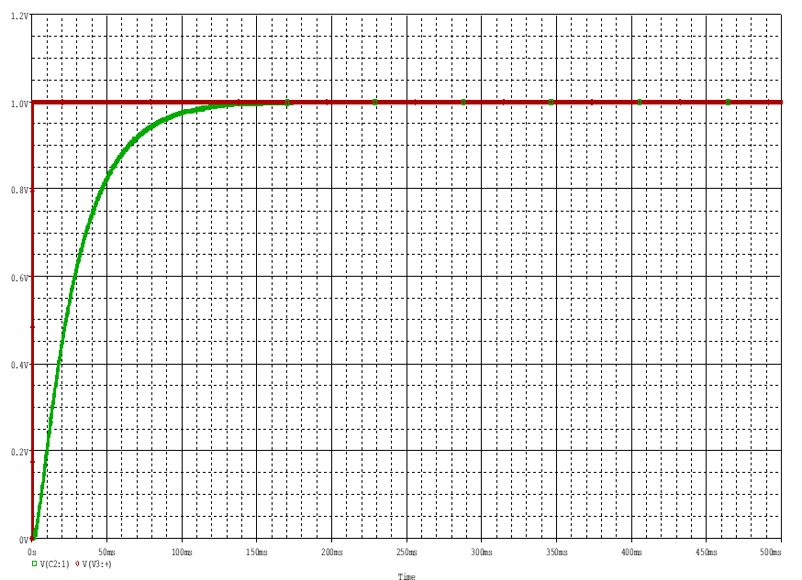
Effects of Proportional, Integral and Differential Block individually
Step Response without PID

Slide 18
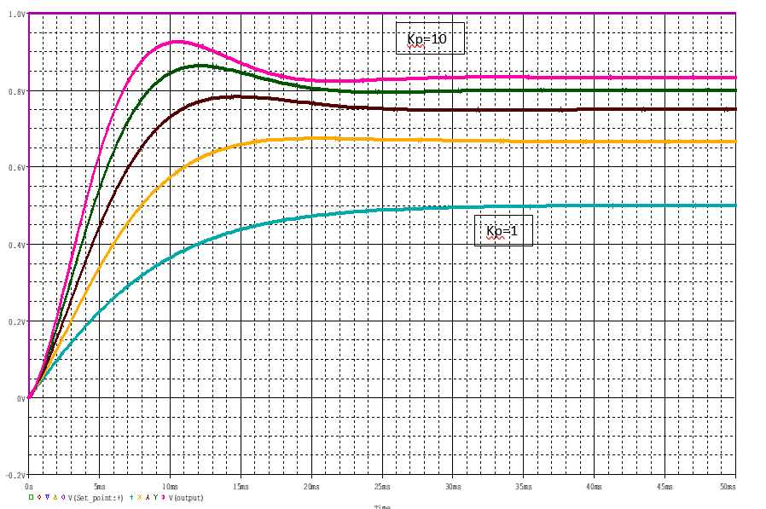
Step Response with varying K_{p} (Holding K_{d} and K_{i} constant)

Slide 19
Observations
The steady state error decreases
The rise time decreases
The overshoot increases
The setting time increases

Slide 20
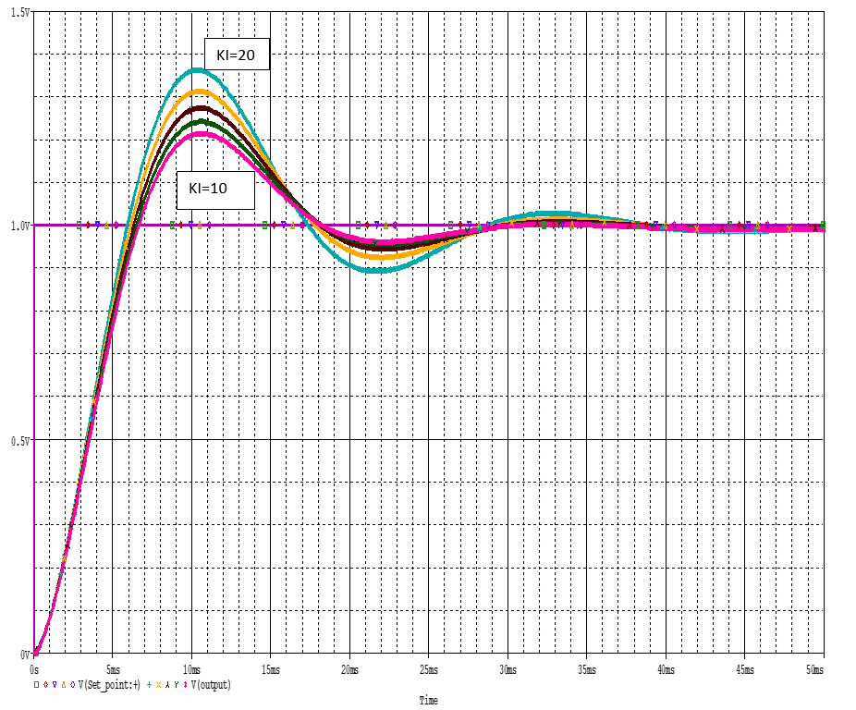
Step Response with varying K_{i} (Holding K_{p} and K_{d} constant)

Slide 21
Observations
The rise time decreases
The setting time increases
The steady state error tends to 0
The overshoot increases

Slide 22
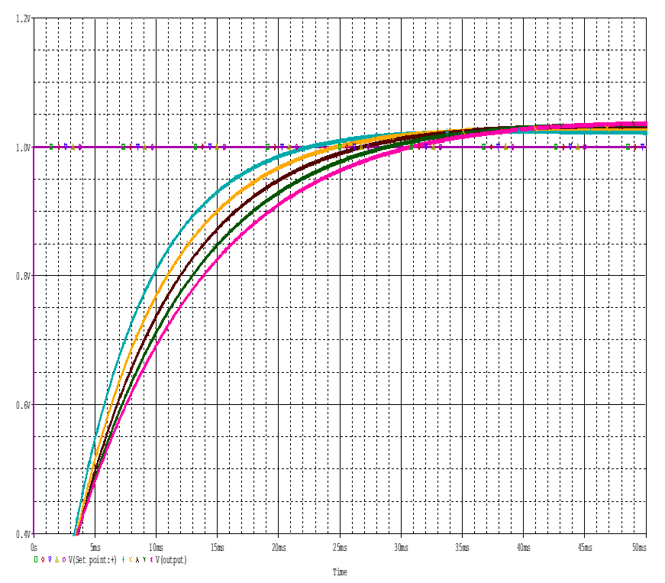
Step Response with varying K_{d} (Holding K_{p} and K_{i} constant)
Kd=10
Kd=20

Slide 23
Observations
The rise time increases
The setting decreases
The overshoot decreases (no overshoots)
Steady state error remains unchanged

Slide 24
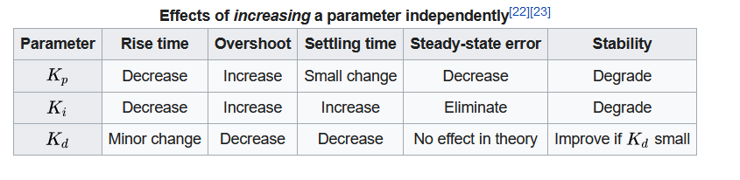
Summary

Slide 25
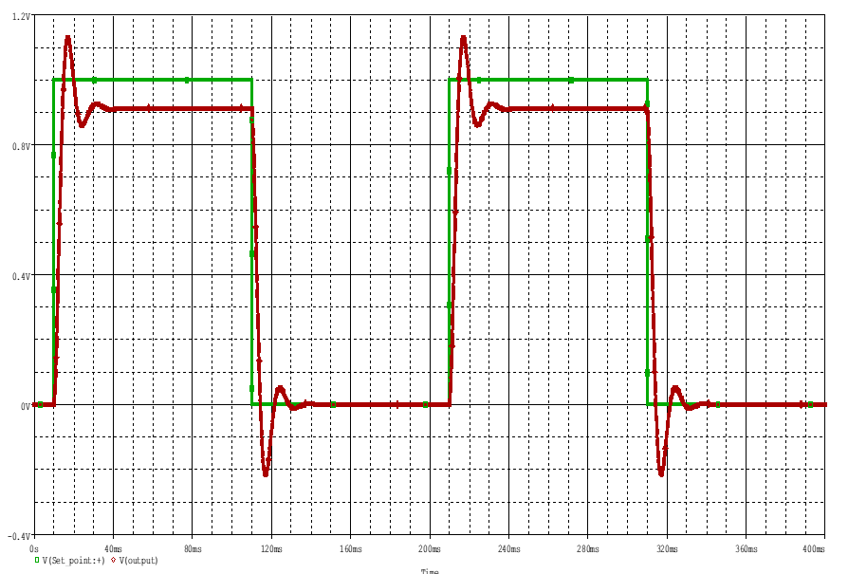
Tuning Procedure
Step:1 varying K_{p} (Making K_{d} and K_{i} zero)

Slide 26
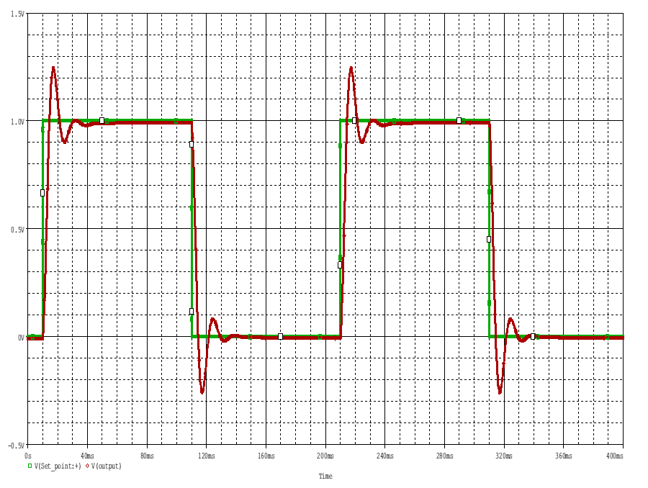
Step:2 varying K_{i} (Holding K_{p} constant and K_{d} = 0)

Slide 27
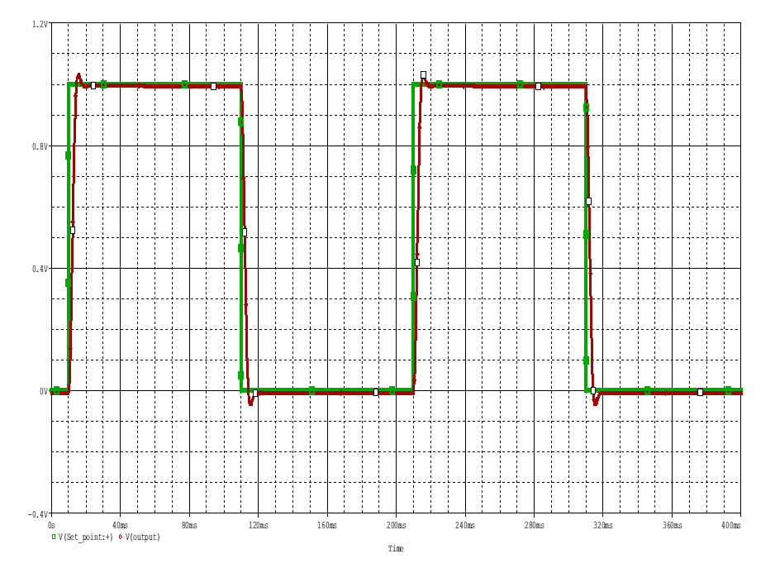
Step:3 varying K_{d} (Holding K_{p} and K_{i} constant )

Slide 28
The tuning is complete. We got our desired output by tuning the PID controller. We can tune more to get even better output curve which entirely follows the step input. The accuracy level we got is adequate for the practical purpose of our plant.
Here, after tuning , we got
Kp=1
Kd=0.001
Ki=10

Slide 29
THANK YOU

